Slide 1
User profile and personalization with add-in model
Vesa Juvonen
Senior Program Manager
Microsoft

Slide 2


Agenda
Introduction
Yammer integration with sites
Custom attribute replication
Customization patterns

Slide 3
Developer vision
USERS
DATA
HTML
Notes:
Our Office 365 developer vision focuses on the Users’ experience and their data. As a developer you can bring your applications into their user experience. With over 1.2+ billion users of Office Worldwide, this is a huge opportunity to provide a window into your applications. As well as being able to connect into their data and add intelligence to your applications. There are currently 850 million events created a month and a total of 470Pb+ of data stored in the service that can add value to for our Users’.

Slide 4

Recommendations
C#
Avoid customizations in OneDrive sites
Avoid metadata in OneDrive sites
Use Yammer for social capabilities
Use CSOM for user profile operations
Notes:
Vesa

Slide 5
Introduction

Slide 6
User Profile CSOM - Introduction
Provides access to following capabilities
User profile access
Reading of profile properties
Change user profile picture
Reading supported in all platforms, updating only in Office 365 for now
Provide feedback if needed for on-premises using Office Dev User Voice
Manipulation of user profile property configuration (admin operations) is NOT available with remote APIs
Can be used from .NET applications or from JavaScript
.NET - Microsoft.SharePoint.Client.UserProfiles.dll
REST - http://<siteUri>/_api/SP.UserProfiles.PeopleManager
JavaScript - SP.UserProfiles.js
Notes:
Vesa
SharePoint 2013 includes new Social CSOM API, which can be used to provision the personal my site or also to access the personal my site remotely, which is actually the key for changing the branding elements in the site. By using this API set, you can built a pretty simple provider hosted application, which will actually modify personal sites or SkyDrive Pro experience based on company branding. After code has been written, it’s just ensuring that it’s executed for the users properly, by placing add-in part to for example public my site host page or just as well you could place the same add-in part to front page of the intranet, to ensure that branding is applied or updated when end users access the SharePoint.
For more information check out my blog post on MSDN: Customizing SharePoint 2013 personal sites using SP Apps with remote provisioning:
http://blogs.msdn.com/b/vesku/archive/2013/08/29/customizing-sharepoint-2013-personal-sites-using-sp-apps-with-remote-provisioning.aspxe

Slide 7
“User profile property value editing is only for SharePoint Online, why not for on-premises”
Resources and priorities
We would love to hear from you on User Voice if you desire this - http://officespdev.uservoice.com. Notice that in on-premises you can always do workaround for this limitation, which is not available in Office 365.
Notes:
Vesa

Slide 8

Using profile properties in customizations
What
Access user profile properties in customizations to check different stored values for specific user
Why
Provide easily personalized experiences dependent on user attributes
For example: different links, images, areas, maps or other content based on user office location
How
Use either .NET client object model (provider hosted) or JavaScript API (SharePoint hosted) to build logic to limit what’s being shown based on user attributes
Notes:
Vesa

Slide 9
User Profile Manipulation with CSOM
Demo
https://github.com/OfficeDev/PnP/tree/dev/Samples/UserProfile.Manipulation.CSOM

Slide 10
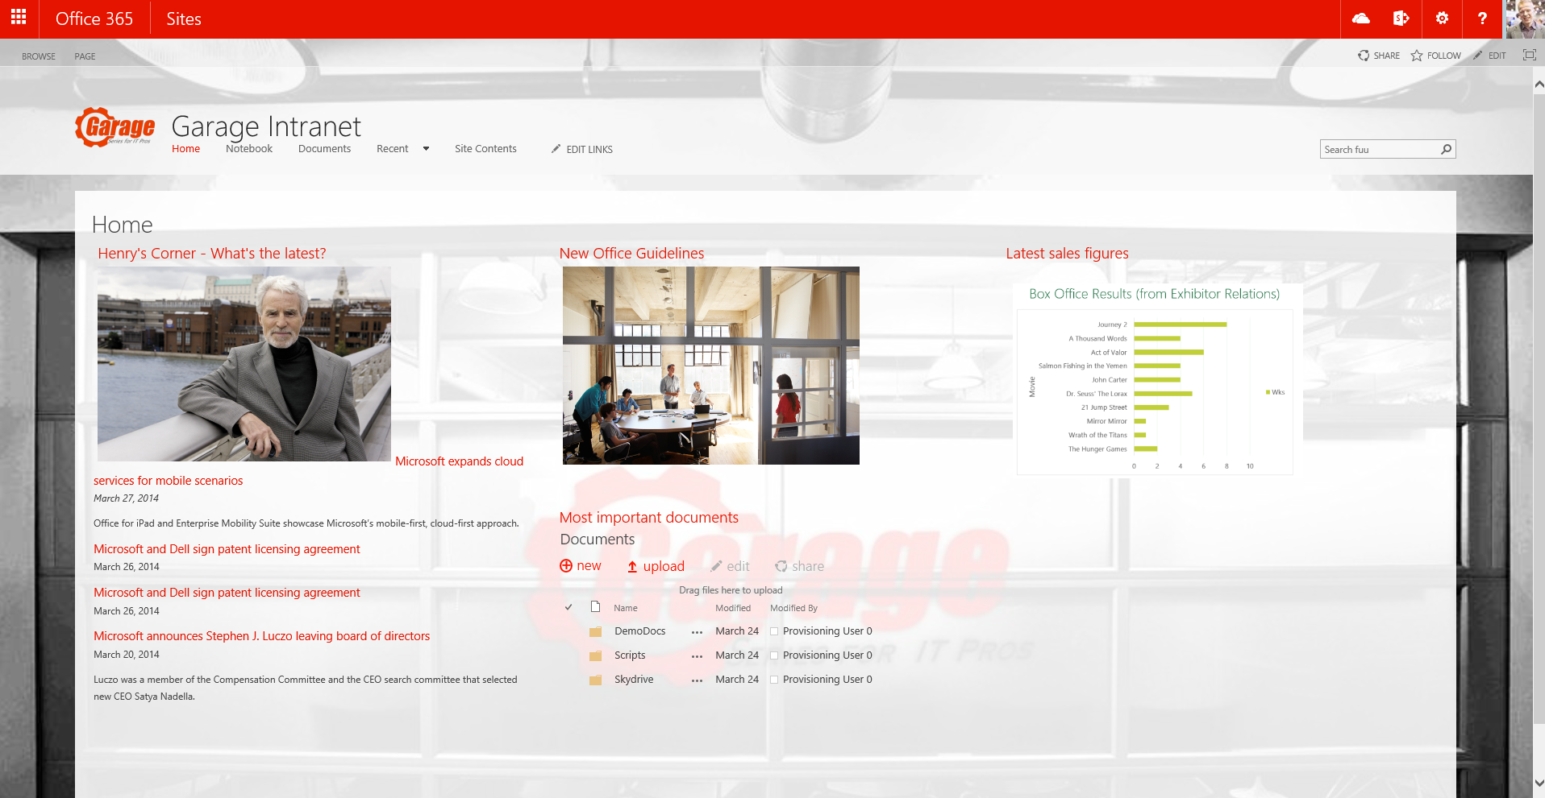
Example scenarios with user profiles
Personalized image and link to country level sites in front page
Cross site collection navigation with personalized links
Personalized information based on role of the particular user
Show personalized news for particular user’s organization, including global news.
Link lists, images, weather and so on based on user profile data.

Slide 11
Custom attribute replication

Slide 12
Custom Attribute Replication
What
Updating all of your user profiles from an external LOB System, or on prem SharePoint Profiles.
Why
You may desire that your users have consistent profiles as well as profile properties that can be used across the different SharePoint Environments.
SharePoint Profile Properties only receive a limited number of attributes from AAD and this cannot be extended.
How
Remote job that updates profile properties based on either on-prem SharePoint Properties and/or external LOB systems.
Notes:
Steve

Slide 13
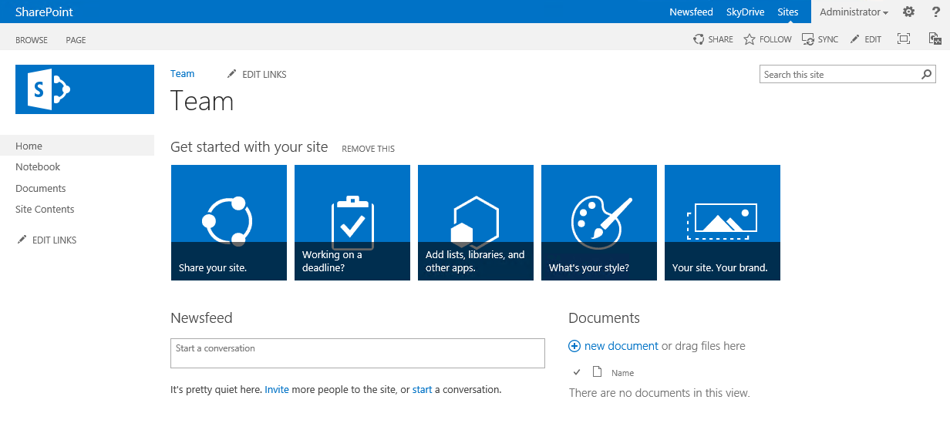
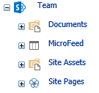
User profile sync and usage process
Customer
SharePoint Service
2
Azure Active Directory
1
Active Directory
5
Standardized set of attributes which are replicated to the SharePoint user profile store.
3
4
Custom synchronization tool
LOB System
Functionalities can use the user profile properties to show information or to change the end user experience.
Custom synchronization tool for extended attributes what needs to be sync'd to SharePoint User profile hosted in Azure, on-premises or in both depending on needed actions
On-premises LOB system for possible extended attributes
Notes:
AD information is replicated to the Azure AD using DirSync or other sync tool. You can control what information is replicated at attribute by attribute level.
With Office365, standard set of AD attributes are replicated to the Office365. This replication cannot be modified in cloud, but it can be modified in on-premises
If you have requirement for additional user attributes, separate customized synchronization tool is needed for replicating the user profile information to the cloud. This tool can be hosted in the on-premises or in the Azure depending on detailed use case. If the needed attribute is replicated to Azure AD, it can be running in the Azure platform and be responsible of replicating the needed attributes from the Azure AD to SP user profile store. If the attributes are only available in on-premises, tool would be running in context of the on-premises and would contact directly SharePoint user profile store for updates.
User profile information can be used to present information or for example to alter the end user experience based on the user profile attribute. Most simplified example would be to show for example weather based on the office location of the user, which is available from user profile.

Slide 14
Yammer with sites

Slide 15
Yammer and SharePoint
What
Integrate Yammer social feeds with SharePoint sites
Why
Combine social capabilities from Yammer with SharePoint collaboration capabilities
How
Use Yammer embed or REST APIs
Embedding can be easily added to any page
Can be configured to be present in site during site provisioning
Notes:
Vesa

Slide 16
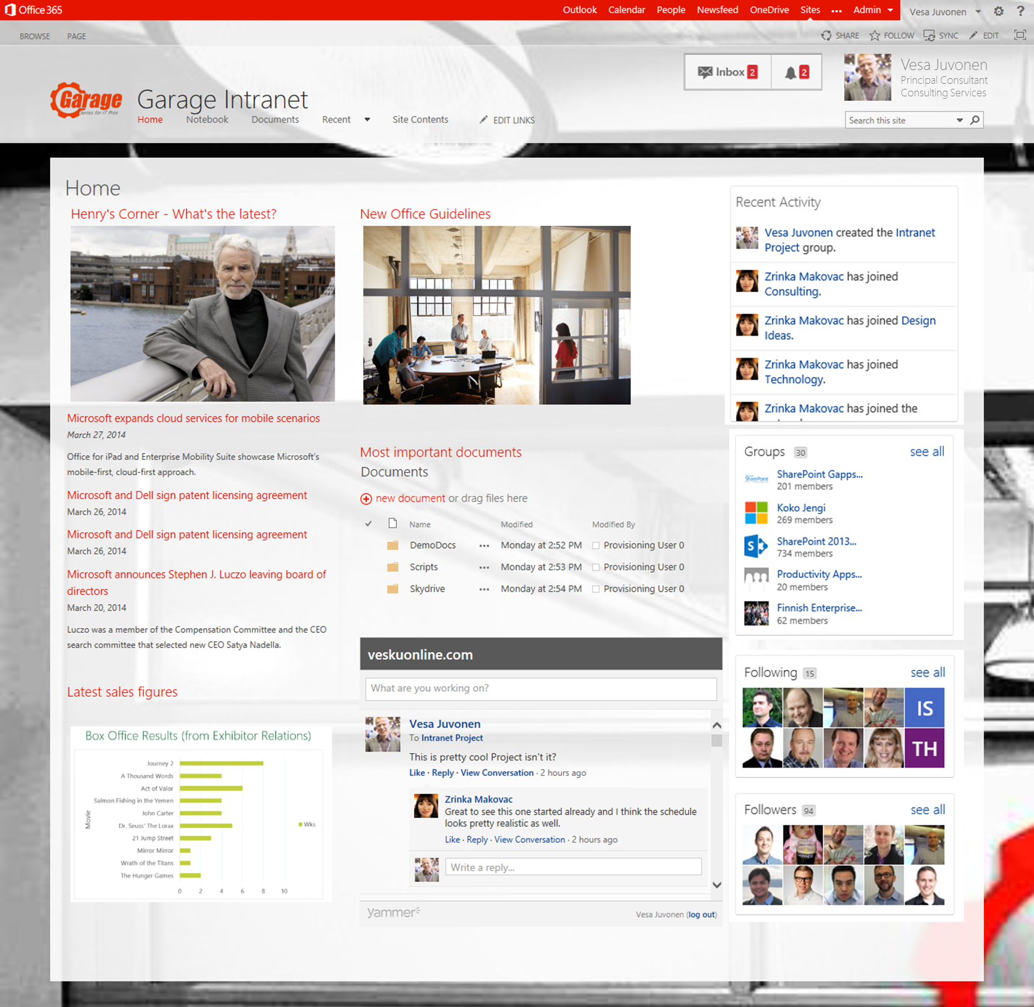
Yammer integration to SharePoint Sample Scenario
User profile and latest notifications
Latest user network activities
Communities and groups
Personal messages feed directly in the front page of the Intranet or specific group feeds in the other sites
Create page specific discussions using OpenGraph option for specific URL
User’s network
Notes:
Vesa

Slide 17
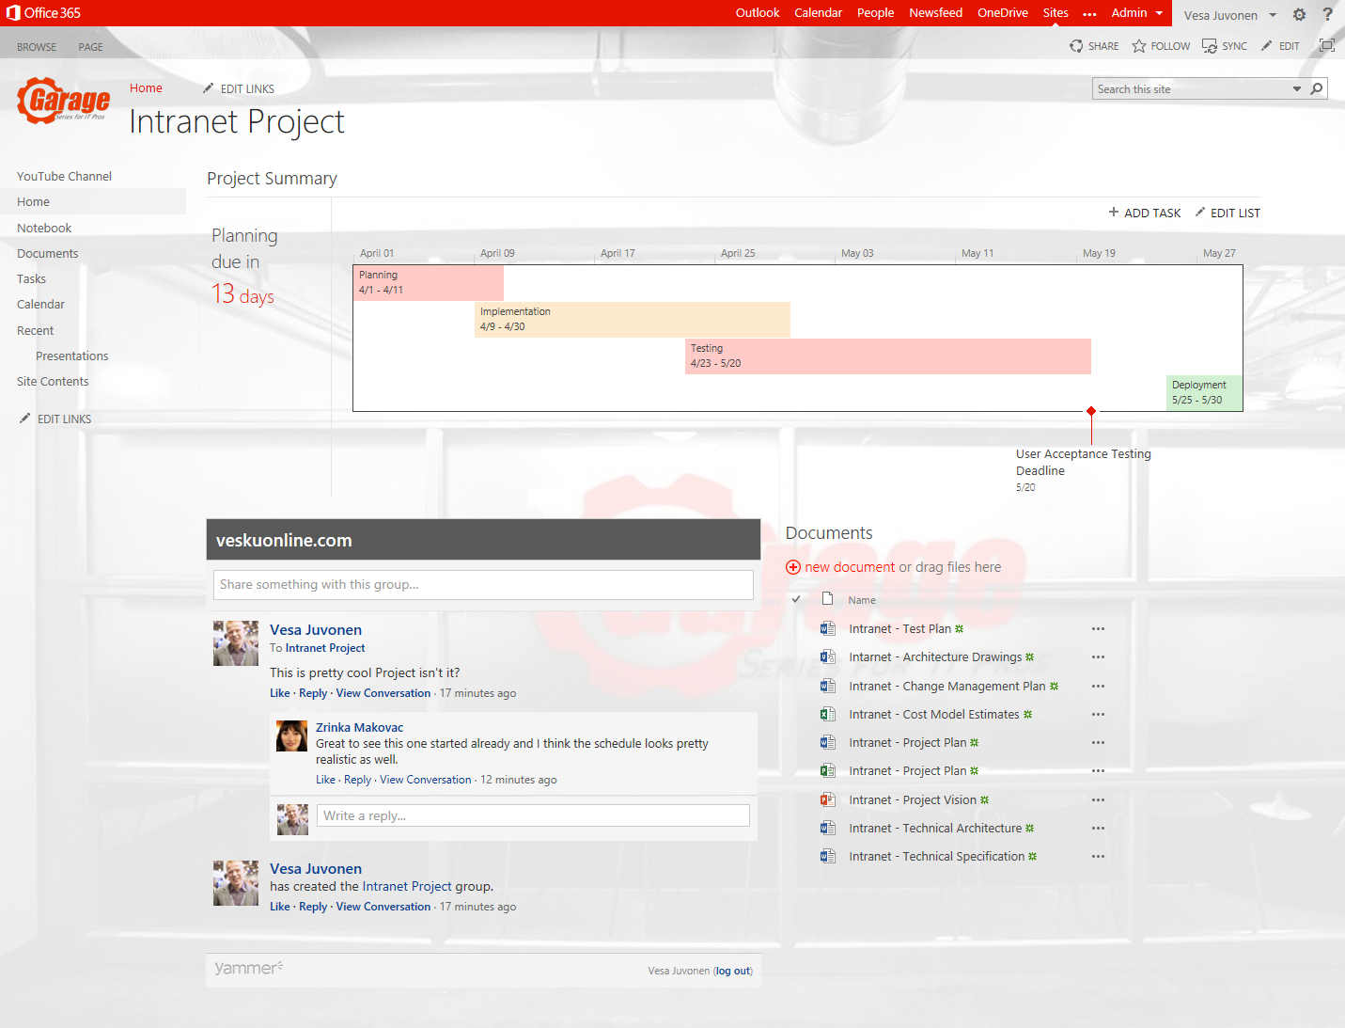
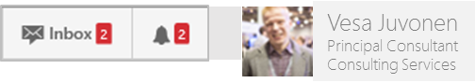
Yammer integration to SharePoint Sample Scenario
User profile and latest notifications
SharePoint team site with Yammer integration
Embedded group feed. Group created automatically for the team site as part of the team site provisioning.
Notes:
Vesa

Slide 18
Hybrid Social Experience with Yammer
SharePoint Service
SharePoint Service
Regional UPA
Regional UPA
Regional UPA
SharePoint Service
Notes:
Vesa

Slide 19
Yammer integration to team sites
Demo
Manual association for Yammer feeds to SharePoint – How to do in practice?
Note. See following for automation: https://github.com/OfficeDev/PnP/tree/dev/Scenarios/Provisioning.Yammer

Slide 20
OneDrive for Business

Slide 21
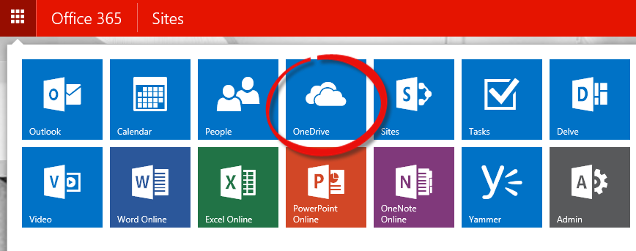
How Do Users Get Personal Sites?
Normal interaction with Office 365
Normal interaction with Office add-ins
Sign in to desktop add-ins
Run OneDrive sync client
Migration tools
Create, then push content
Bulk pre-create for large scale rollouts
Notes:
Steve

Slide 22
Pre-create personal sites in cloud
What
Pre-create OneDrive for Business sites for specific accounts
Why
To avoid wait times when people access the OneDrive for business for the first time or to perform pre-create sites to enable content migration from on-premises to the cloud
How
New APIs added to the cloud for SP2013 SP1. Can be called from CSOM or from REST interfaces
Notes:
Steve

Slide 23
Bulk Site Creation: New CSOM API in SP1
String _adminTenantUrl = "https://youradmin.sharepoint.com"; // You don't want to provision more than 200 users personal sites during a single request.
// If you have a large amount of users consider // waiting for the last users site to be provisioned. The reason behind this is not to bombard the service with requests. string _restPayload = "{'emailIDs':['user1@MicrosoftACS.onmicrosoft.com', 'user2@MicrosoftACS.onmicrosoft.com']}";
SharePointOnlineCredentials _creds = new SharePointOnlineCredentials(userName, Utilities.StringToSecure(password)); _context.Credentials = _creds; _context.ExecuteQuery(); ProfileLoader _profileLoader = ProfileLoader.GetProfileLoader(_context); _profileLoader.CreatePersonalSiteEnqueueBulk(emailIDs); _profileLoader.Context.ExecuteQuery();
Notes:
Steve

Slide 24
Calling CSOM from PowerShell
$webUrl = https://yoursharepointadmin.SharePoint.com $ctx = New-Object Microsoft.SharePoint.Client.ClientContext($webUrl)
$web = $ctx.Web $username = admin@myadmin.sharepoint.com $password = read-host – AsSecureString $ctx.Credentials = New-Object Microsoft.SharePoint.Client.SharePointOnlineCredentials($username,$password )
[System.Reflection.Assembly]::LoadWithPartialName("Microsoft.SharePoint.Client.UserProfiles") $loader =[Microsoft.SharePoint.Client.UserProfiles.ProfileLoader]::GetProfileLoader($ctx)
#To Get Profile $profile = $loader.GetUserProfile() $ctx.Load($profile) $ctx.ExecuteQuery() $profile
#To enqueue Profile $loader.CreatePersonalSiteEnqueueBulk(@("user1@domain.com")) $loader.Context.ExecuteQuery()
Notes:
Steve

Slide 25
“What about OneDrive for Business customizations?”
Personal OneDrive for Business site is created automatically for the person when they visit their personal OneDrive site…
Notes:
Steve

Slide 26
Manipulating OneDrive for Business sites
What
Modify personal OneDrive for Business sites automatically for end users
Why
Provide branding, document management features or other configurations to the sites
Governance tasks related to OneDrive sites.
How
Can be achieved by accessing the personal OneDrive for Business site using social CSOM and then injecting the needed configurations to the site
Notes:
Steve

Slide 27
“We do not recommend customizing OneDrive for Business sites!”
With the new OneDrive for Business experience, customization options are limited for enabling faster innovation on the service.
Notes:
Steve

Slide 28
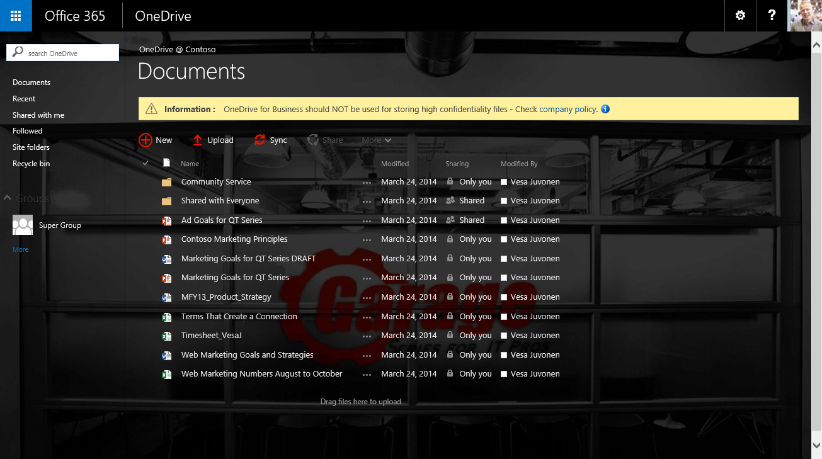
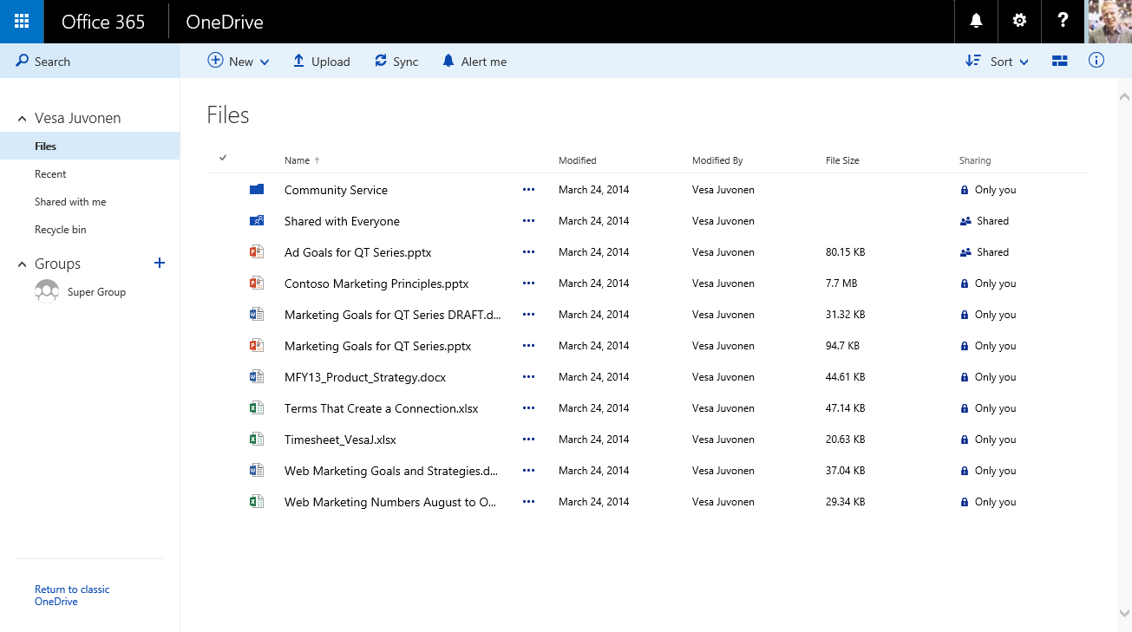
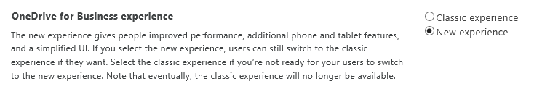
New OneDrive for Business experience
Old experience
Supports some level of customizations – below picture has custom theme and embedded JavaScript
New experience
More aligned with the consumer experience with additional enhanced capabilities
Does not support customizations
You can control default experience from SharePoint admin UIs

Slide 29
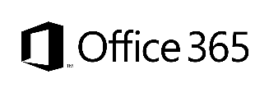

Customization options with OD4B sites
Office 365 Themes
SharePoint Theme
Alternate CSS
Embedded JavaScript
Can be used to centrally control branding cross all services in the Office 365
Mainly color scheme settings
Only in Office 365, not in on-premises
Can be used to control branding, fonts and background image on the collaboration sites
Not supported with OneDrive for Business sites
Can be used to override whatever CSS settings
Control to color, fonts and even layout settings
Configuration applied to each site collection separately
Full control on what you want to embed on the site
Configuration applied to each site collection separately
Dependent on page structure, which can cause maintenance challenges
Options
Support with classic experience
Not supported
only
Support with new experience
Not supported
Not supported
Not supported
only
Flexibility
Fair
Good
Good
Cost impact (short and long term)
Note. Supported options have been updated during autumn 2015

Slide 30
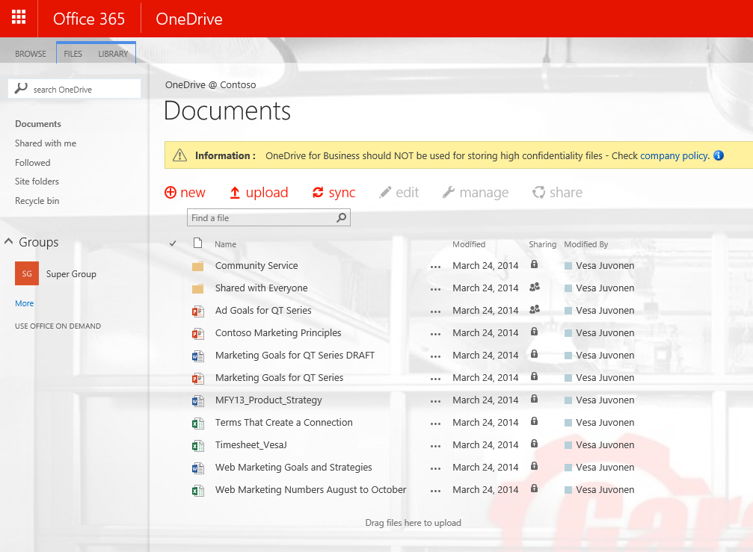
OD4B customization with add-in part model -for old experience
Provider Hosted add-ins
2
SharePoint
<<Add message>>
<<instantiate>>
Add-in part
1
Storage Queue
3
OD4B
<<instantiate>>
WebJob
<<Apply modifications>>
5
4

Slide 31
Timer job based process -for old experience
We use worker role or web job for querying newly created sites to the OD4B side
Site branding is not automatic and has the delay with search
Remote timer job is scheduled to be running in Azure and is using querying OD4B sites using search
Sites are branded when timer job is processed
OD4B
1
Remote timer job
2
<<Loop through site collections>>
Notes:
Steve

Slide 32
Pre-Create and apply changes - for old experience
Use the OD4B pre-creation site API to create the sites for each of the end users
Apply needed changes after site has been provisioned, but before end users will access the site
New users will require to be then taken into account specifically
OD4B
<<pre-create and customize>>
2
1
Notes:
Steve

Slide 33
“Does this mean that there is no IMMEDIATE customization option?”
Correct
Only the pre-created site option will provide you this option. There’s no hook to add code when the site is being provisioned, so this action has to be applied separately.
Notes:
Vesa

Slide 34
Applying branding automatically to OneDrive for Business sites (Async model)
- for old experience
Demo
https://github.com/OfficeDev/PnP/tree/master/Solutions/OD4B.Configuration.Async

Slide 35
Recommendations
C#
Avoid customizations in OneDrive sites
Avoid metadata in OneDrive sites
Use Yammer for social capabilities
Use CSOM for user profile operations
Notes:
Vesa

Slide 36
Questions?

Slide 37

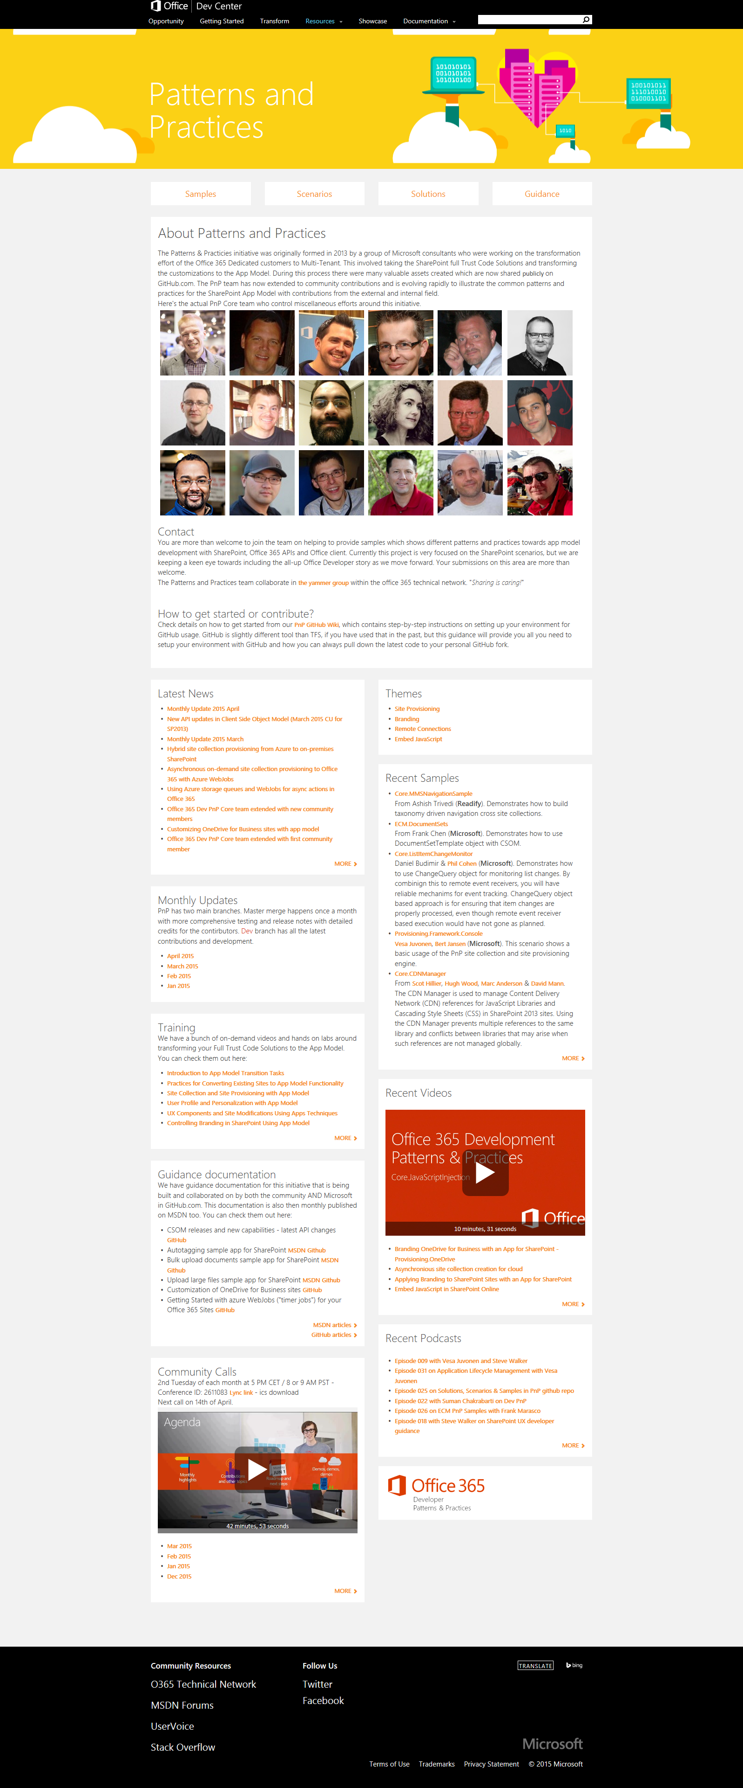
“Sharing is caring”
aka.ms/OfficeDevPnP
aka.ms/OfficeDevPnPYammer
aka.ms/OfficeDevPnPMSDN
aka.ms/OfficeDevPnPVideos
aka.ms/OfficeDevPnPTraining

Slide 38


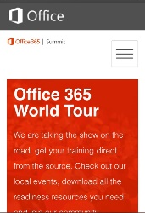
dev.office.com
Sign up
http://dev.office.com/getting-started
Explore
http://apisandbox.msdn.microsoft.com
Get trained http://dev.office.com/training

Slide 39


Feedback
Office 365 Network Share you best practices and join conversations
https://www.yammer.com/itpronetwork
Stackoverflow Ask deep technical questions to a world-wide set of developers
http://stackoverflow.com/questions/tagged/ms-office
UserVoice Provide suggestions of what you want in future versions
http://officespdev.uservoice.com/

Slide 40


© 2015 Microsoft Corporation. All rights reserved. Microsoft, Windows, and other product names are or may be registered trademarks and/or trademarks in the U.S. and/or other countries.
The information herein is for informational purposes only and represents the current view of Microsoft Corporation as of the date of this presentation. Because Microsoft must respond to changing market conditions, it should not be interpreted to be a commitment on the part of Microsoft, and Microsoft cannot guarantee the accuracy of any information provided after the date of this presentation. MICROSOFT MAKES NO WARRANTIES, EXPRESS, IMPLIED OR STATUTORY, AS TO THE INFORMATION IN THIS PRESENTATION.

